Slide 1
Data Warehouse Project Fudge-Mart CORP.
Jeremy Rozon
Dan Burke
Kwaku Poku
Notes:
KP Intro

Slide 2
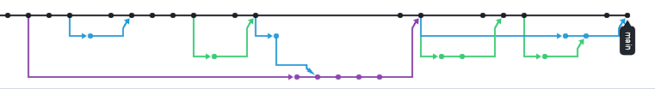
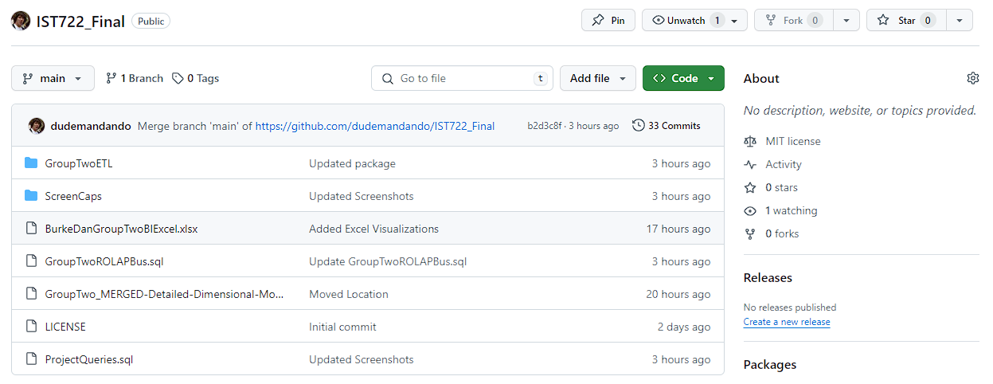
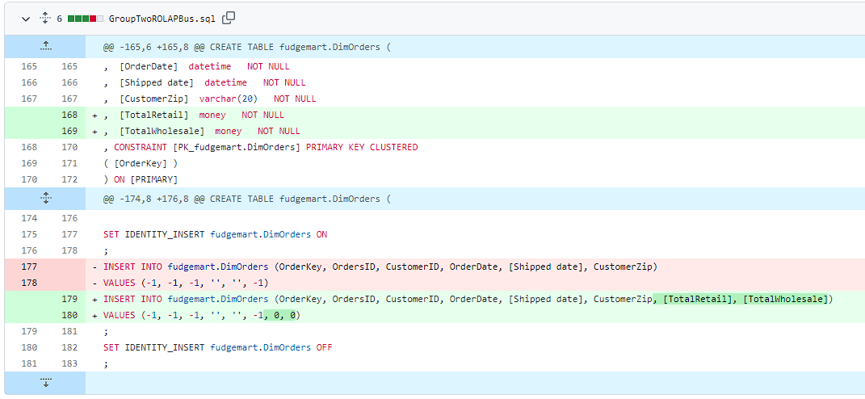
Code/Project Management
Repository Working Tree
https://github.com/dudemandando/IST722_Final
Differential Capture
Notes:
Dan Explains Version Control

Slide 3

Business Case
Overall Goals & Objectives:
Enhance Fudge-Mart Corp's sales strategy to identify any gaps in their current market.
Analyze the needs of the Datawarehouse To make business recommendations
Conduct analysis on combined Fudge-flix and Fudge-mart data
Notes:
Jeremy

Slide 4

Key Focus:​
Provide actionable recommendations for business improvement
Perform analytics on both Fudge-flix and Fudge-mart creating a deployable data pipeline from source to stage to Data Warehouse. Data is available to external tooling.
Notes:
Jeremy

Slide 5

Business Questions
Geographics Customers & Subscribers to Fudge-Mart Corp thus far.
Which State Generated the Most Revenue?
Which State produced the highest and lowest ratings.
Notes:
KP

Slide 6
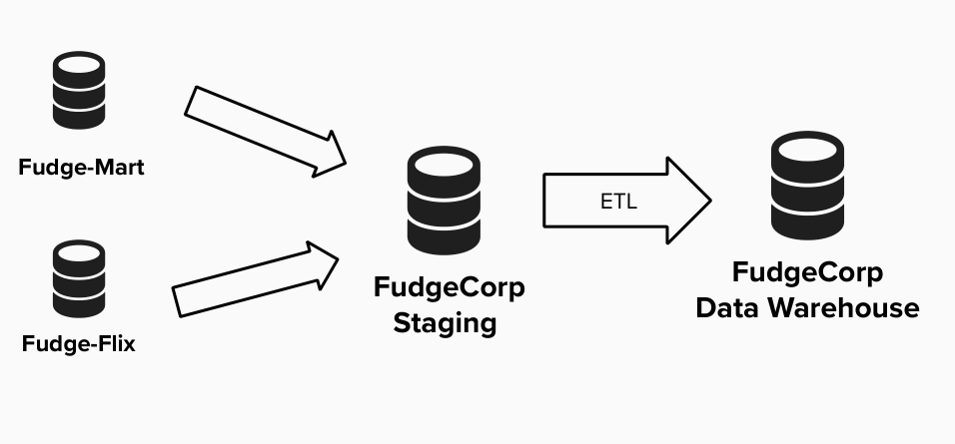
Process Map
ETL Tools:
SSIS, SSMS
BI Tools Used:
Microsoft Excel
Notes:
KP

Slide 7
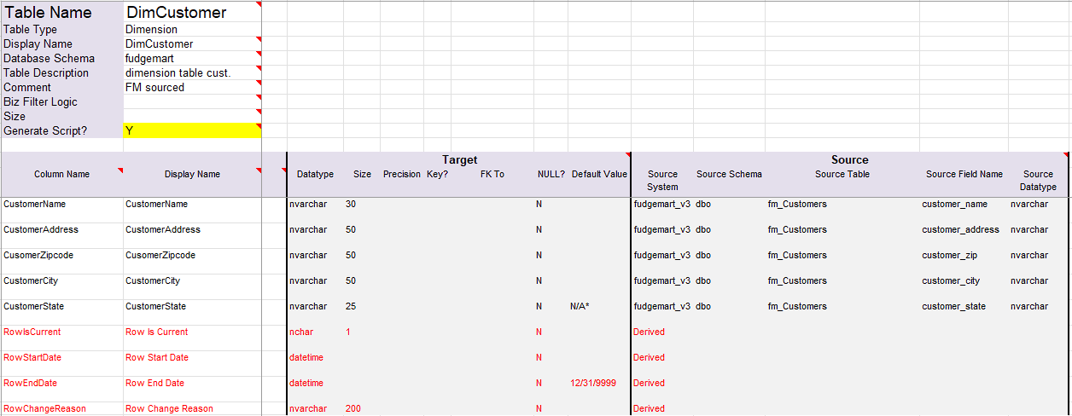
High & Detailed Level Dimension Modeling
Notes:
KP

Slide 8
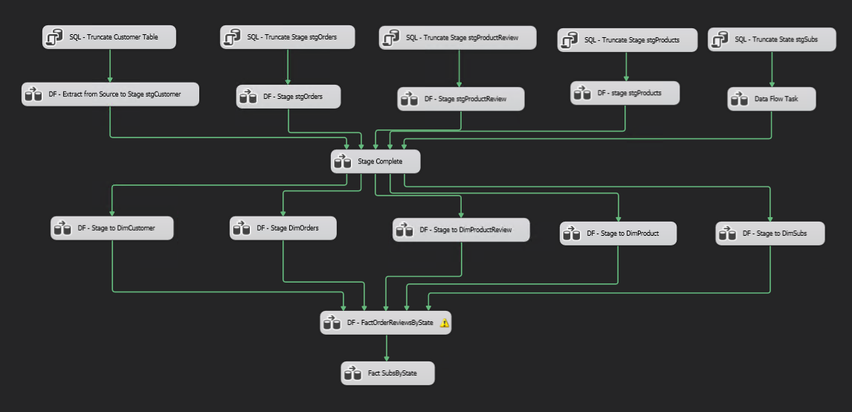
Overall Package
Notes:
DAN

Slide 9
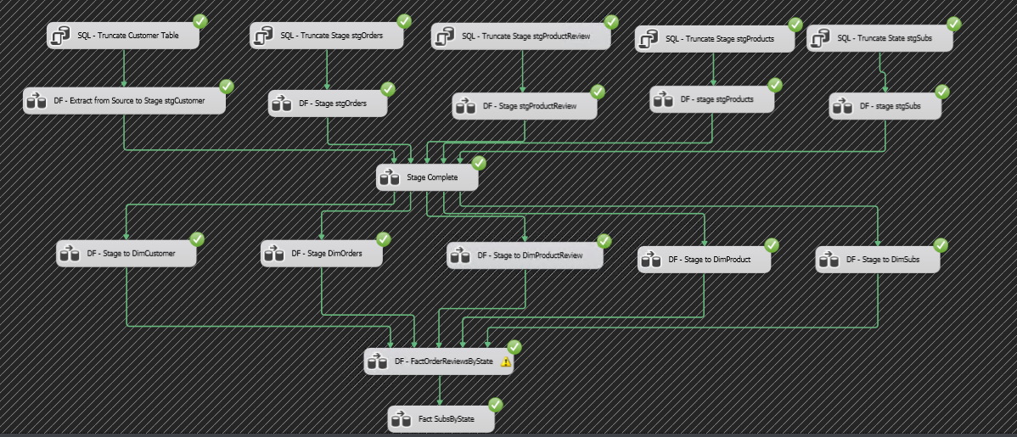
Overall Package
Notes:
DAN

Slide 10
Staging
Dim Load
Fact Table Load
Notes:
Dan

Slide 11
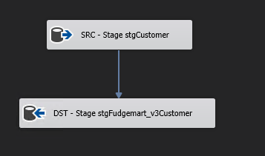
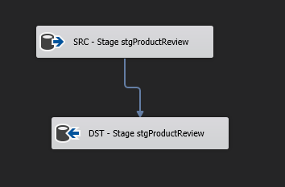
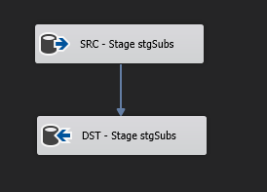
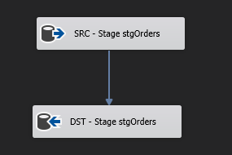
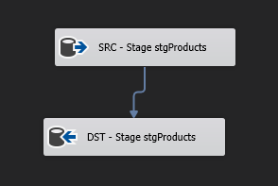
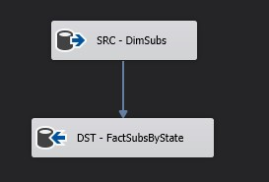
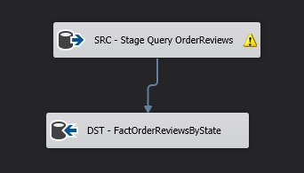
ETL - Extraction Phase
Notes:
Dan

Slide 12
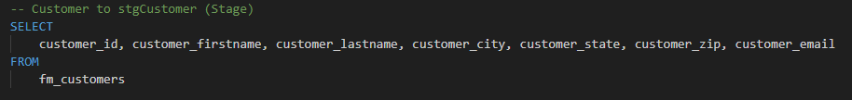
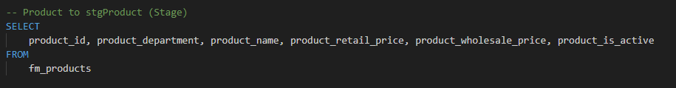
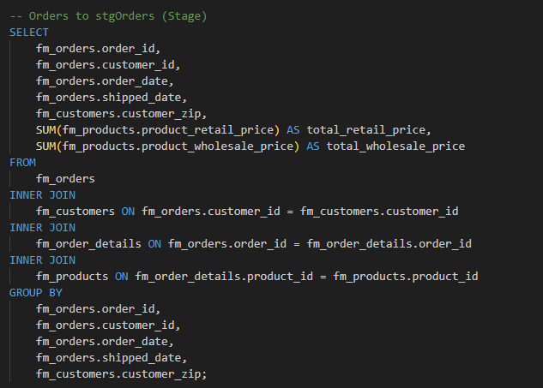
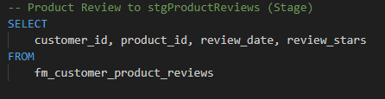
Staging SQL Queries
Notes:
DAn

Slide 13
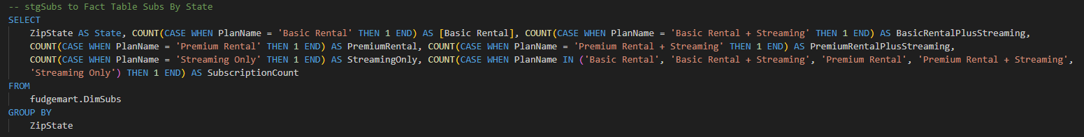
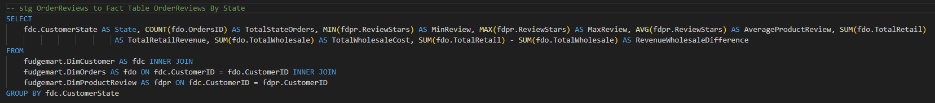
Fact Table SQL Queries
Notes:
DAn

Slide 14
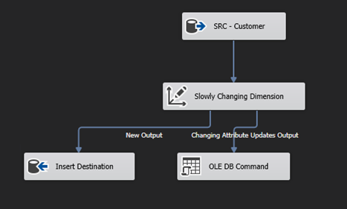
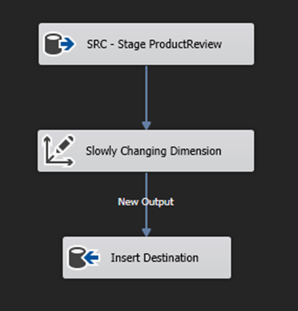
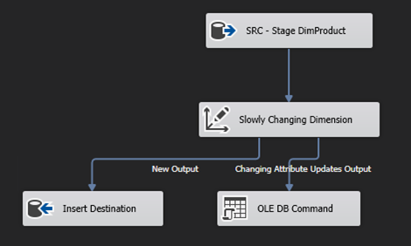
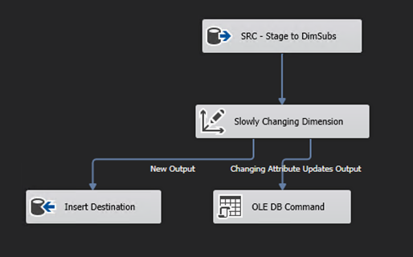
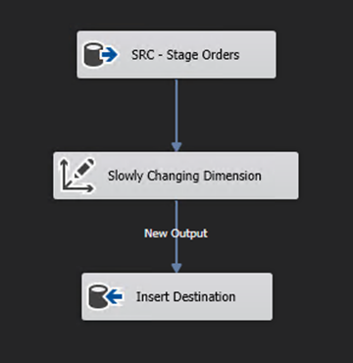
ETL - Loading Phase
Customer
Product Reviews
Products
Subscriptions
Orders
Notes:
Dan

Slide 15
Business Questions Revisit
Geographics of States for the company & Subscribers to Fudge-Flix thus far.
Which State Generated the Most Revenue?
Which State produced the highest and lowest ratings?
Notes:
Jeremy

Slide 16
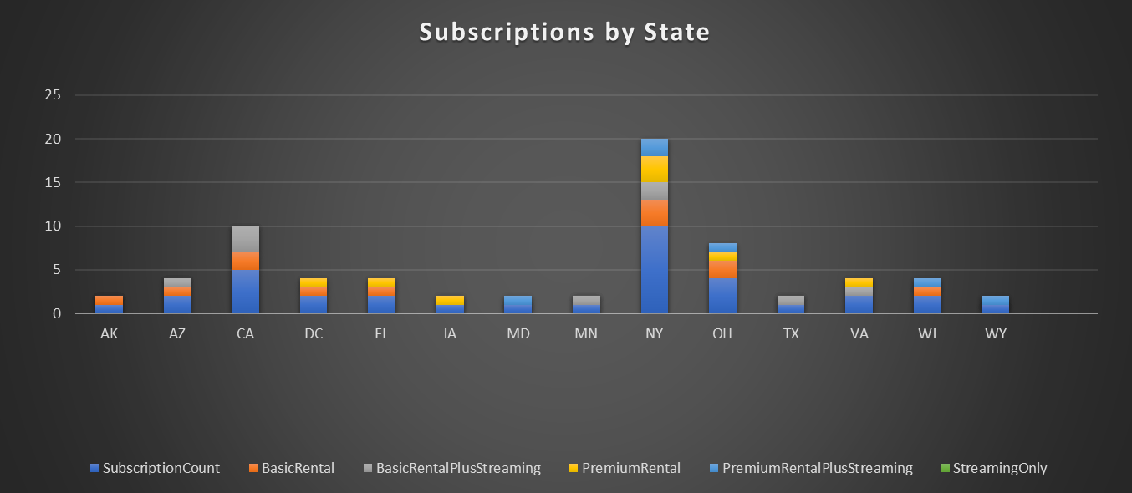
Geographics of Fudge-Corp Customers & Subscribers to Fudge-Flix thus far.
Notes:
Jeremey

Slide 17
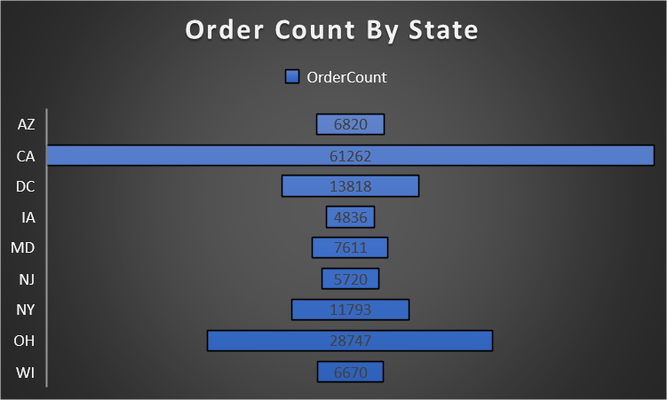
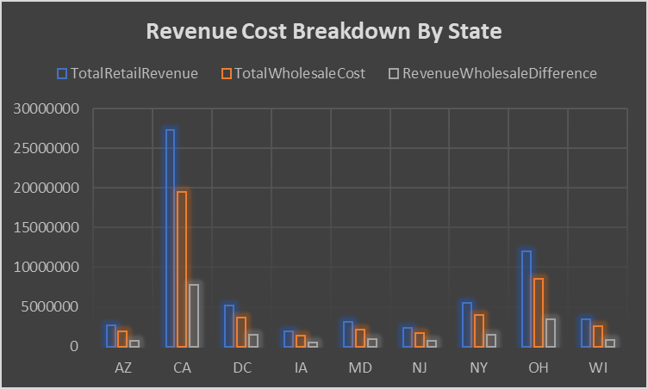
Which State Generated the Most Revenue?
Notes:
Dan

Slide 18
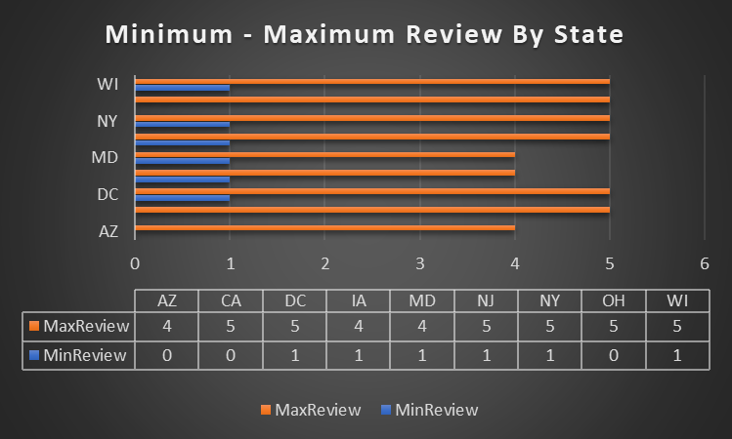
Which State produced the highest and lowest ratings?
Notes:
KP

Slide 19
Recommendations
Fudge-Corp possesses a non-congruent presence on both the east and west coasts of the United States, this indicates there may be a gap in the market
Fudge-Corp does possess a presence with low customer engagement in Texas and Florida as compared to high customer engagement in New York (which holds a comparable population); a potential near term course of action to increase shareholder value would be to expand operations and presence (either by Marketing or Sales) within these higher population states which Fudge-Corp already possesses a presence.
Notes:
Dan speaks

Slide 20
Questions

